Slide 1
Shane Pill
shane.pill@flinders.edu.au
http://www.flinders.edu.au/people/shane.pill
Fontys Sporthogeschool
Eindhoven
May 19th 2017

Slide 3
This Presentation
Conceptualising play with purpose
The Game Sense approach for tactical and technical skill learning
Teaching sport with “the brain in mind
Explicit teaching
Implications for PE teaching and sport coachin
Practical: Touch Football

Slide 4
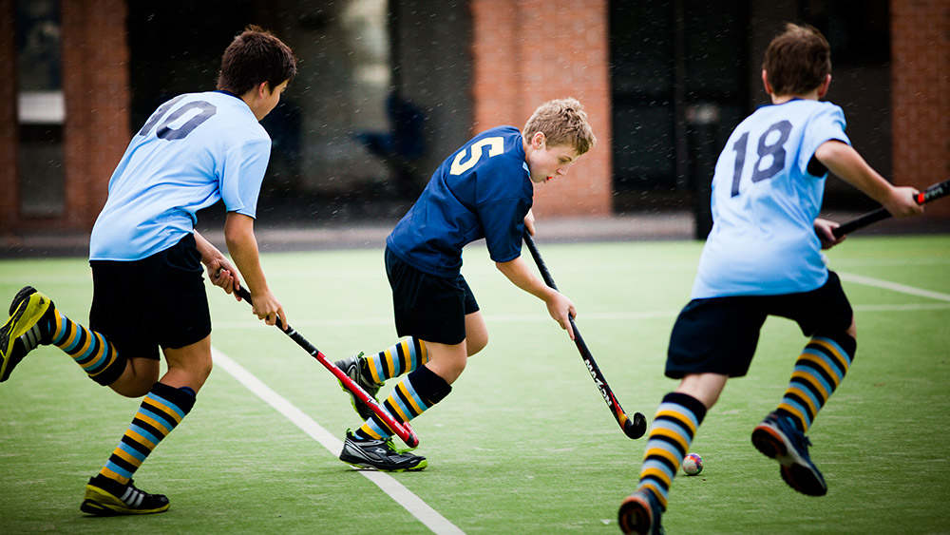
Idea 1. Play with Purpose
To take part in…
To Perform
To Compete
To Participate
The reason for which something is done or created
What one intends to do or achieve
Deliberate Design

Slide 5
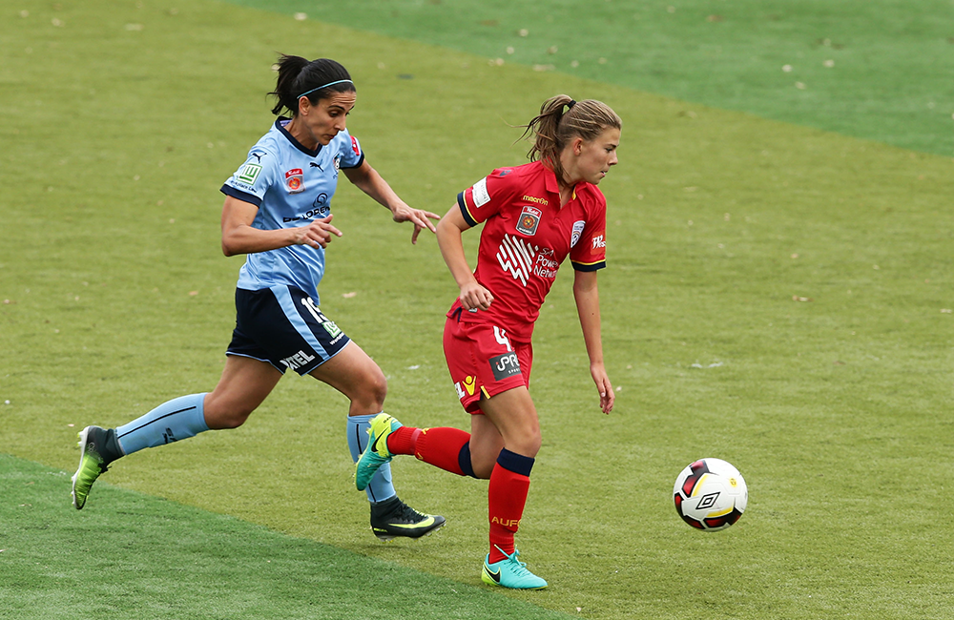
Idea 2.
Physical education and sport are spaces where cognitive behaviour is observed by the physical performance

Slide 6
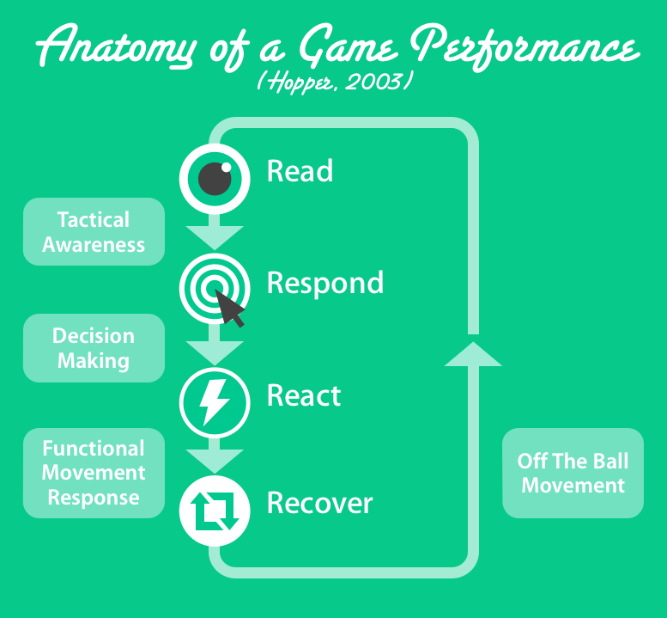

Slide 7
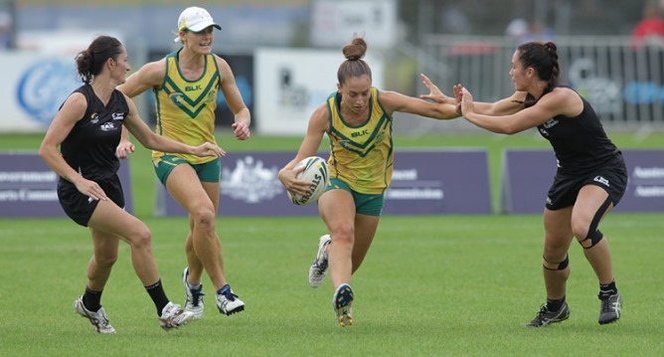
Idea 3.
Young people want to:
Have fun
Touch the ball
Score goals
*Playing games for training works with young peoples motivation to play
Youth and adults we say
“Practice how you want to play”
So
*Play for practice

Slide 8
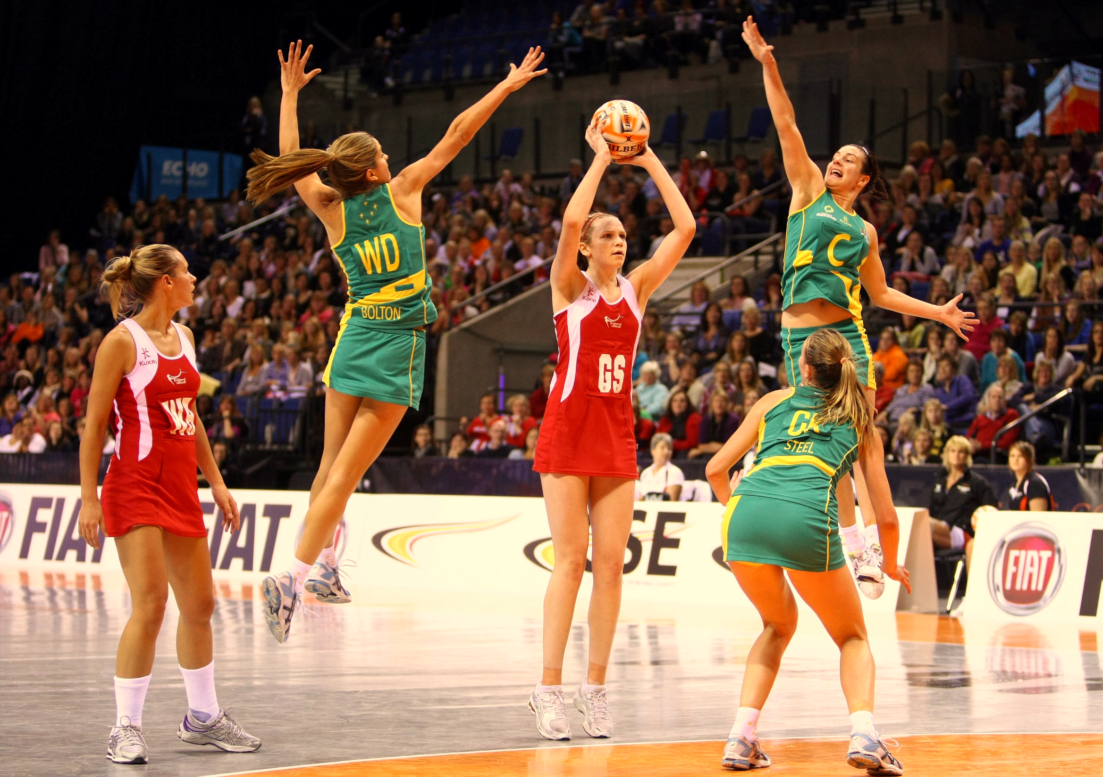
Game Sense Approach(Australian Sports Commission, 1996)
Game Based – NOT game only
The “realistic context” of a game or a game-form “becomes the focus and starting point of practical sessions” (Australian Sports Commission, 1996, p. 1)
The Game Sense approach is therefore described as a “game-based” model
Scaffolding and Shaping Learning
Focus play by game design
Shape play (player thinking) by questions
Develop thinking players (action-perception) by representative task design

Slide 9
Idea 4.
Developing thinking players
*Representative practice contexts to develop action specific perception ability and information-action coupling for decision-making acuity and efficacy

Slide 10
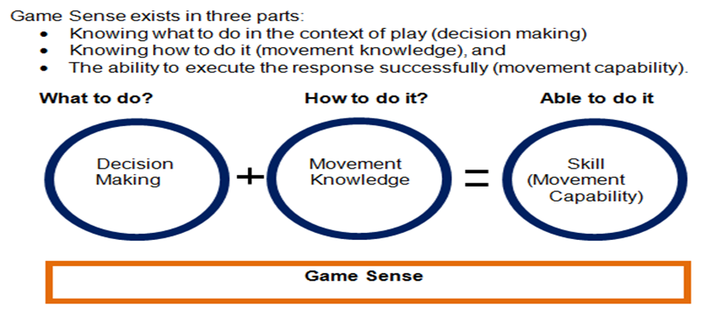
The Game Sense equation
(Pill, 2013, p. 7)

Slide 11
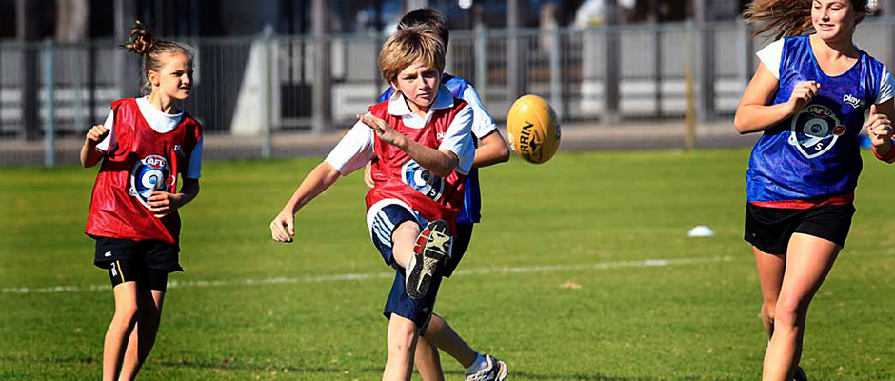
Idea 5.
Skill is technique applied to solve the problem of the moment in play
It has complimentary technical and tactical components
*Develop biomechanical sound adaptive techniques

Slide 12
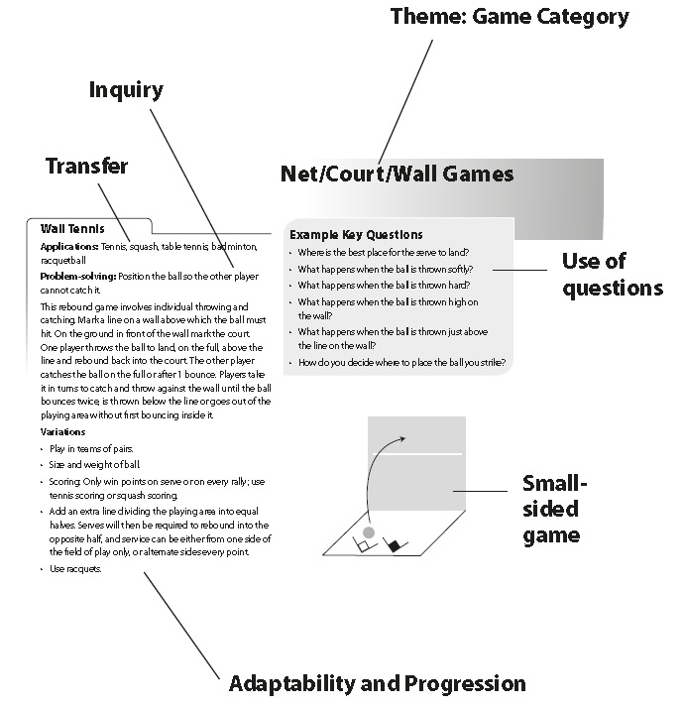
What does it look like?

Slide 13
What does it look like?
Practice Plan
Traditional Planning Contemporary 1 Contemporary 2 (Children & Youth) (Adult)
Warm-up Game Closed to Open Drills
Drills leading to game Practice Match Simulations
Warm-down Game “Craft” practice
Begins with content Begins with Concepts
eg. Tactical Concept: Maintain Possession
eg. Strategy: On-the-ball #Passing on 45s
Strategy: Off-the-ball # Passing triads

Slide 14
Closed to Open Drill
A good warm-up drill!
Perhaps an isolation and regression activity to emphasise a point

Slide 15
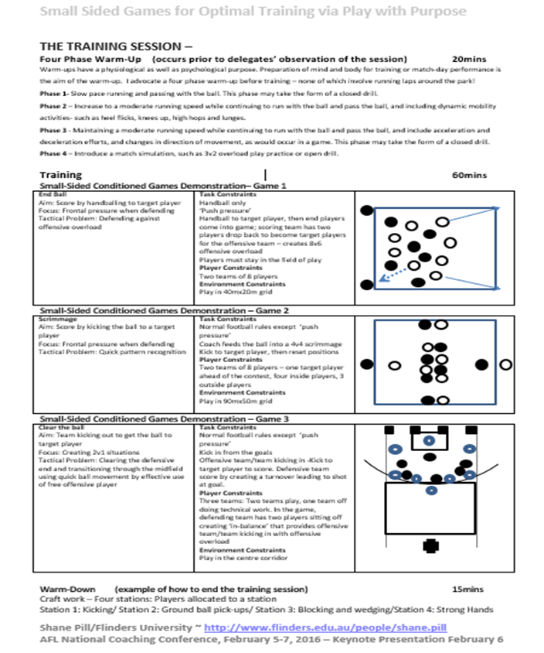
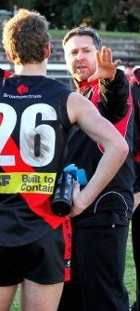

Slide 16
In PE
Game
Reflect
Practice
Game

Slide 17
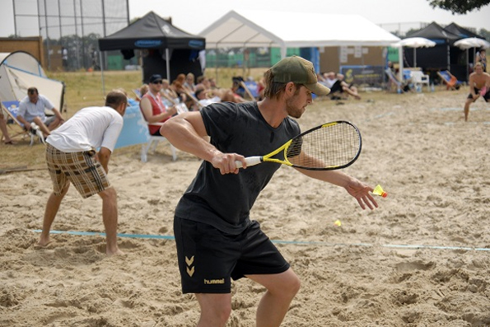
Some Implications for PE and Sport
1. Clear Learning Intention
2. Explicit teaching - strongly guided teaching has a greater learning effect than weakly guided ‘implicit’ teaching
Guidance “specifically designed to support the cognitive processing necessary for learning” is advantageous (Kirschner, Sweller & Clark, 2006, p.76)
3. Scaffold
Physical
Cognitive Social

Slide 18
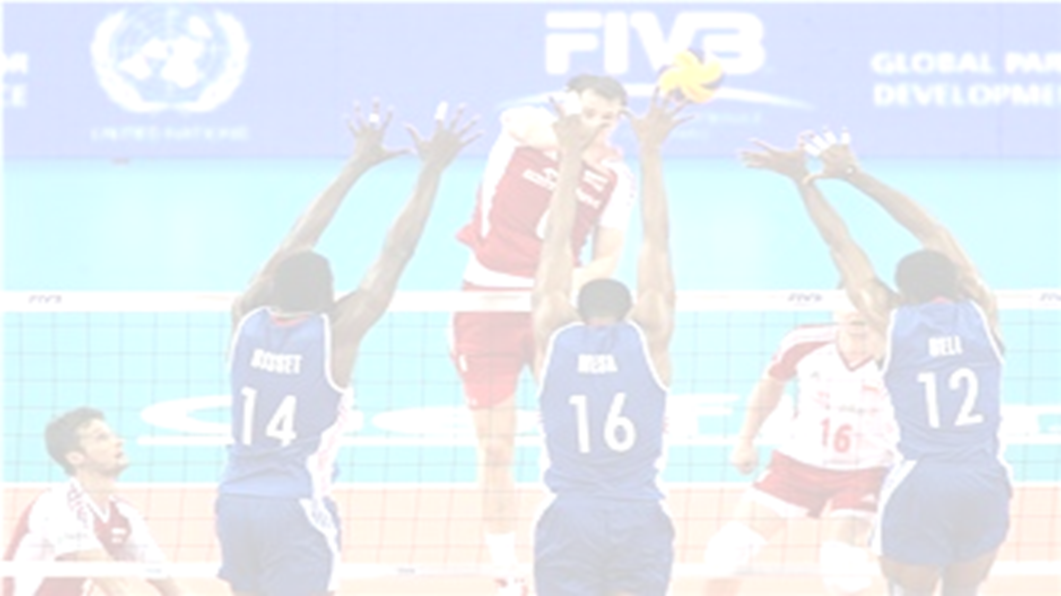
Shape the Environment
More Time & Space
More Congestion
CHANGE AREA SHAPE
LARGER PLAY AREA
More Speed
Less Time & Space
Different Movement Patterns
Different Movement Patterns
More Free Space
More Contests
More Long Passing
More Short passing
CHANGE THE GOALS
SMALLER PLAY AREA
More Run & Carry
More Tackles & Blocks

Slide 19
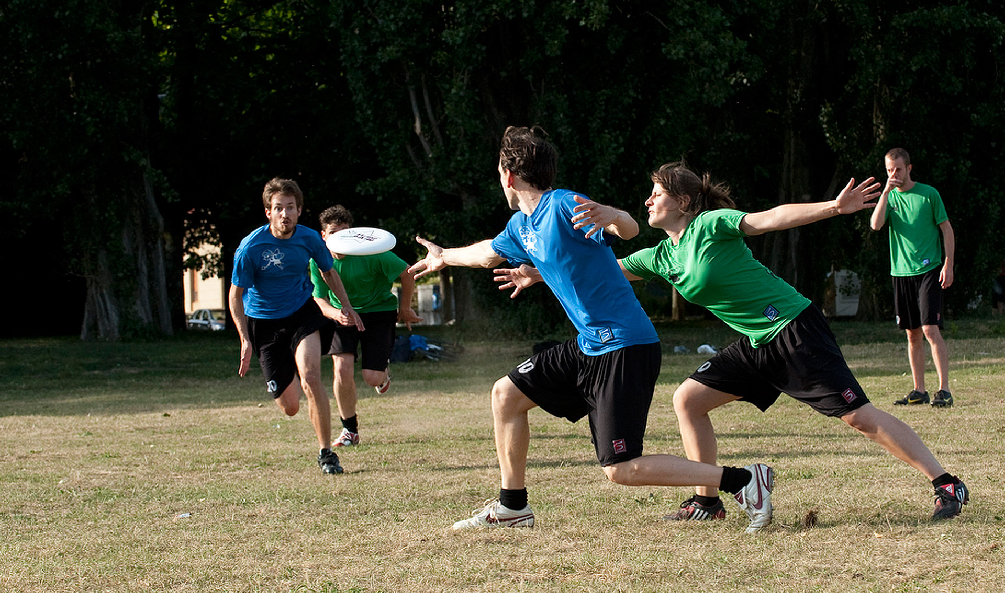
Focus the Players: Task Constraints
Score a particular way
Score from a part of the ground
Team ball movement- Fast play
-Slow play
Vary scoring options
TASK
Team shape
- Bubbles
Umbrella
Formations
Starting points
Phase of Play
Channel opponents ball movement

Slide 20
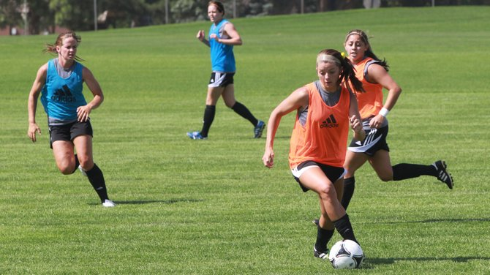
Shape and Focus Thinking –
Ask Questions?
 | Who? | What? | Where? | How? | Why? | When
Time
Space
Force
Direction
Flow/Tempo
Control
Consistency

Slide 21
Idea 6.
Play with Purpose: Game Sense as a Developmental Continuum
Fundamental Movement Skills
Fundamental
Sport Skills
Refining Sport
Specific Skills
Developing Attack and Defence Structures
Developing a Game Plan

Slide 22
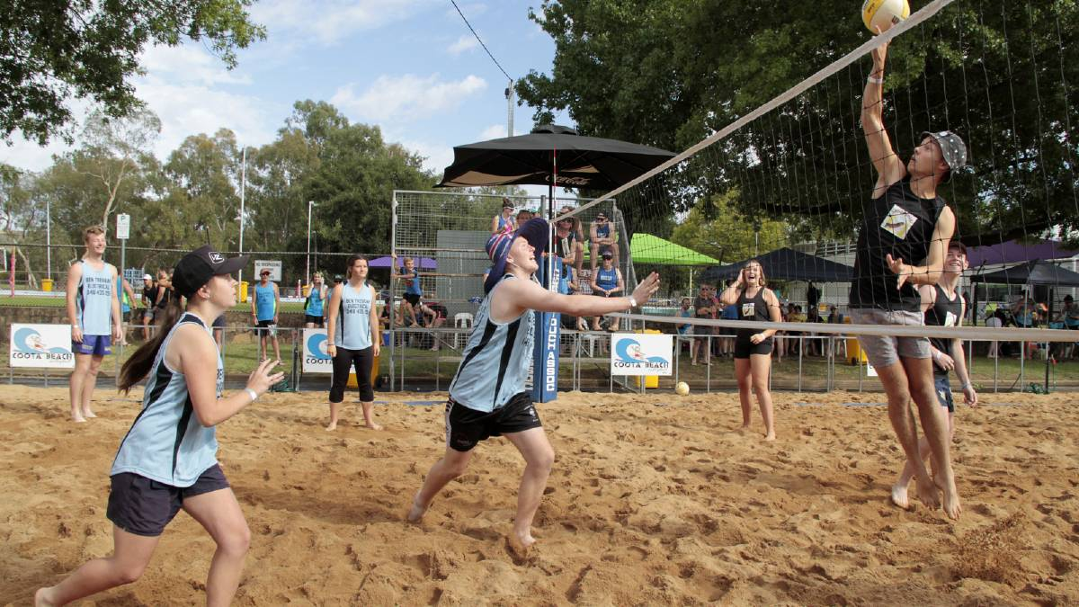
In Summary…
Behavourist “Physical Education Method” | Constructivist – social and cognitive constructivism
Games and Sport as techniques | Sport as Principles of Play/Game Concepts
Technique replication | Flexible, adaptive but biomechanically sound movement models
Technical before tactical | Technical and tactical components are complimentary pairs
Game last | Game first
Many different experiences | Coherent progressive complexity
Teacher content decisions | Content decisions based on student interest, readiness and community availability – Strengths Based Perspective

Slide 23
The Game Sense Approach as Explicit Teaching And Deliberate Practice
Shane pill, Flinders University, Adelaide, Australia

